Slide 1
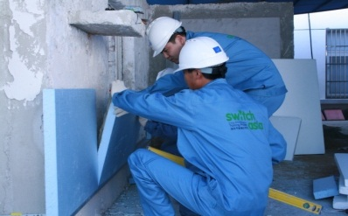
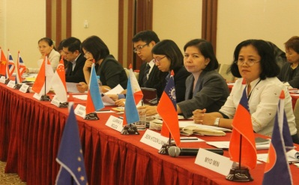
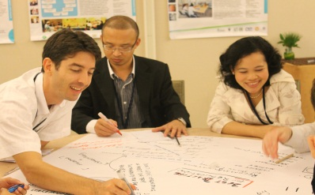
SWITCH-Asia II
Promoting Sustainable Consumption and Production (SCP)
in Asia and Central Asia
The information session will start
at 09:30 Brussels time
All questions related to this call for proposals can be sent to
EuropeAid-SWITCH-ASIA@ec.europa.eu

Slide 2
Information session - Agenda
1. Overview of SWITCH Asia programme
2. Call for proposals: main information
(objectives, priorities, target groups, geographical coverage, duration, type of activity, etc.)
3. Call for proposals: finance and contracts rules
(eligibility criteria, costs, submission rules, etc.)
4. How to apply and procedures to follow
5. Indicative calendar

Slide 3
1. Overview of SWITCH Asia programme

Slide 4
Regional Indicative Programme (RIP) Asia 2014-2020 Priority sectors
TOTAL: EUR 889,5 million
Sectors | Budget | Allocation as percentage | Programmes/Actions
Promotion of Green Economy | EUR 440,5 million | 49% | SWITCH-Asia, FLEGT, green investment through blending (Asia Investment Facility)
Regional integration | EUR 320 million | 36% | Support to ASEAN regional integration, Mekong River area, Trade-related assistance to non-ASEAN countries and other sub-regional programmes
Aid to Uprooted people | EUR 122 million | 14%
Support measures | EUR 7 million | 1%

Slide 5
SWITCH ASIA Programme
BACKGROUND
Many developing countries in Asia and Central Asia find themselves in the midst of a rapid industrial transformation (the fastest growing source of new greenhouse gas emissions in the world)
Need to decouple economic growth from the environmental degradation and natural resources depletion
Several countries are among the most vulnerable to climate change and natural disasters

Slide 6
SWITCH ASIA Programme
MAIN OBJECTIVES OF THE PROGRAMME
promote inclusive sustainable growth
contribute to the economic prosperity and poverty reduction in Asia and Central Asia
support the development of a green economy and the transition towards a low-carbon, resource-efficient and circular economy in the 24 target countries
MAIN OUTPUTS
Adoption of sustainable consumption and production practices, particular among MSMEs to be replicated at higher scale
Strengthen the regulatory framework and business related environment
Build capacities for implementing SCP and enhance policy dialogue at national and regional level
Increase the interaction between MSMEs and financial intermediaries (access to finance)
PROGRAMME’S MAIN FIGURES
Launched in 2007
7 calls for proposal (2007-2016)
110 projects funded (EUR 230 million)
Project duration: 36-48 months
Average grant size: EUR 1,5 million
It funded 400 non-for-profit partners, 100 private sector associates, benefitting up to 70.000 Asian MSMEs
Since 2018, it covers 24 countries (extension to Central Asian countries of Tajikistan, Turkmenistan, Kyrgyzstan, Uzbekistan and Kazakhstan)
Notes:
Sustainable consumption and production focuses on reduced environmental impacts and increased resource efficiency, and thereby serves as an operational vehicle for a transition to green economy. By supporting Small and Medium Enterprises to switch towards more sustainable activities, the SWITCH-Asia Programme contributes to diminishing poverty and achieving the Sustainable Development Goals.
The European Commission launched the SWITCH-Asia Programme in 2007 with the aim to promote sustainable consumption and production (SCP) among Asian consumers and micro-small and medium-sized enterprises, and to support Asian policy-makers shifting towards SCP practices. Seven calls for proposal were successfully implemented from 2007 to 2016 (in total around EUR 230 million) and the programme has financed more than 100 projects supporting over 400 Asian and European non-for-profit partners, about 100 private sector associates and benefitting up to 70.000 Asian micro, small and medium-sized enterprises).
In 2018, SWITCH Asia was extended to Central Asia (Tajikistan, Turkmenistan, Kyrgyzstan, Uzbekistan and Kazakhstan). These countries have already expressed various degrees of responsiveness to the SCP agenda in different sectors, from energy efficiency to renewable energy and the development of green tech-companies.
The programme is currently covering 24 countries.

Slide 7
SWITCH-Asia II Components
Regional Policy
Advocacy Component
(targeting policy-makers)
SCP Facility
(general coordination
of the 3 components)
Grants - (pilot) projects
(testing innovative approaches to SCP)
Since 2018
Notes:
7
SCP- Facility: additional activities
→ ONE Programme Networking Event A YEAR for grantees

Slide 8
2. Call for proposals (EuropeAid 161614): main information

Slide 9
Details on 2019 Call for Proposals
Priorities
Lots – new!
Target groups
Sectors – new!
Duration and size of grants
Partnership composition
Type of actions
Notes:
For the following session I would like to briefly walk you through the main structure of the programme and then developing on some of the specificities for this particular call for proposals, namely the Objectives of this particular call for proposals, priorities, the link with the 10year framework of programme, the type applicants and the type of activities expected.

Slide 10
Priorities
Projects should address at least one or more of these priorities
Priority 1: address sustainable supply chains management with a focus on green trade and on facilitating the integration of MSMEs into supply chains.
Priority 2: support sustainable consumption and consumer awareness on SCP.
Priority 3: focus on either large industrial parks and large economic zones or clusters of SMEs in order to produce bankable projects.

Slide 11
Priorities - specificities
Projects in priority 1 and priority 3 should provide:
a clear analysis of constraints encountered in terms of access to finance
concrete solutions and activities to facilitate the access to finance to support SCP
Additional information is provided at page 15 of the guidelines.
Notes:
In combination with the selected activities identified above, projects in priority 1 and priority 3 - should provide:
1. a clear analysis of the types of constraints in terms of access to finance encountered by firms and other productive actors involved in SCP-related activities:
1.1 the distinction between: (a) constraints that are to be dealt with at systemic level, and for which broader interventions of financial sector development would be needed (e.g. legal-regulatory and supervisory issues; financial infrastructure gaps); (b) constraints that can be dealt with by working with stakeholders at the meso and micro levels of the financial sector (e.g. banking training institutes/associations, technical providers in the financial sector, individual financial institutions such as banks, leasing companies, in some cases also microfinance institutions);
2. concrete solutions and activities to facilitate the access to finance to support SCP, e.g. in terms of awareness raising on opportunities and challenges of green finance and capacity building of relevant stakeholders (e.g. at policy and industry levels).

Slide 12
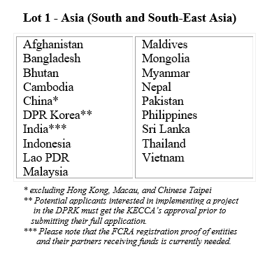
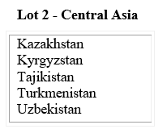
New - Lots
Projects should be made for one of the 2 geographical lots.
Multi-countries proposals are allowed only with countries belonging to the same Lot.
Examples of Multi-countries proposals
Afghanistan + Uzbekistan is NOT ELIGIBLE! (Lot1+Lot2)
Afghanistan + Pakistan is ELIGIBLE (LOT 1).
Uzbekistan + Tajikistan is ELIGIBLE (LOT 2).

Slide 13
New – Lots: budget allocation
EUR 32 700 000
EUR 13 000 000

Slide 14
Target Groups
- Micro, Small and Medium-Sized Enterprises (MSMEs)
Large companies are not identified as beneficiaries of the programme, but engagement with them (e.g. retailers committed to sustainable sourcing) is encouraged.
- Consumer organisations and consumer groups
- Business intermediaries and service providers
(e.g. industry associations, chambers of commerce, clusters, organisations/ associations of MSMEs, retailers, financial institutions, research centres, etc.)
- Trade federations and workers associations
- Not-for-profit organisations
- Governmental institutions, local authorities and government-sponsored entities
(providing support services to MSMEs and/or responsible for policy and regulatory frameworks on SCP and industrial policies)

Slide 15
New - Sectors
Proposals should fall under the following SCP “General sectors”.
General sectors | Examples of sub-sectors (not exhaustive!)
Agri-food processing | processing and production of agri-food/beverages/fish and aquaculture, bamboo processing, etc.
Building and construction | new green materials for constructions, bamboo and traditional bricks processing for constructions/furniture, etc.
Digital economy | blockchain and/or new technologies for energy production and consumption and for consumer engagement, etc.
Energy | energy efficiency, renewable energy linked to manufacturing, biofuels, bio-energy, etc.
Manufacturing | textile and leather, electronics and electrical equipment, machinery, automotive, handicrafts and cottage industries, etc.
Plastics | product design, processing, etc.
Sustainable Tourism | development of ecotourism business models, etc.
Green trade promotion | trade of green products, etc.
Transports and logistics | public/private green transports in urban areas, green freight transports, reduction of environmental impact of warehousing, new technologies for packaging/delivery processes, e-commerce, etc.
Waste management | the whole treatment/proceeding of products from collection to recycling, etc.
Wood processing | timber and rubber processing, etc.
Mining processing | (this sector only applies to Lot 2 – Central Asia)

Slide 16
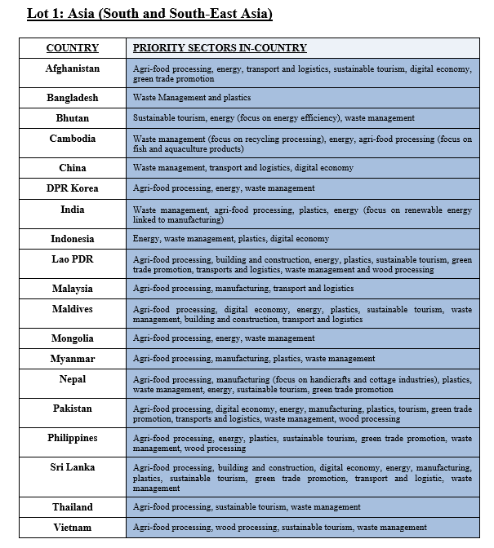
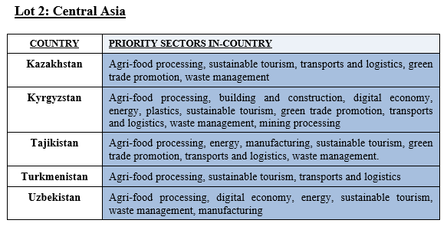
New - Sectors
However, actions targeting “Specific priority sectors in-country” will receive higher score during the evaluation.
The list of sectors by countries is available at page 7 of the guidelines!

Slide 17
New - Sectors
The programme is about improving the production processing/methods and not about the primary production or raw-materials!

Slide 18
Duration and size of grants
Duration of the project: 36-48 months
Size of grants: EUR 1-3 million
Total eligible costs of the action:
Minimum: 50% of the total eligible costs of the action
Maximum: 80% of the total eligible costs of the action (90% for actions taking place in Least Developed Countries-LDC)
LDC = Afghanistan, Bangladesh, Bhutan, Cambodia, Laos, Myanmar and Nepal.

Slide 19
Partnership composition (1)
Each proposal should be submitted by a partnership composed at least by one lead applicant and one co-applicant.
The partnership has to include:
at least one organisation from a Member State of the European Union / European Economic Area or an international organisation
AND
at least one organisation from an eligible Asian or Central Asian country belonging either to Lot 1 or to Lot 2.
Attention: for Asian and Central Asian organisations the action should take place only in the country in which the organisation if registered.
Example: an organisation registered in Sri Lanka cannot implement an action in India but only in Sri Lanka itself!

Slide 20
Partnership composition (2)
Reminder: Multi-countries proposals are possible as long as the countries belong to the same Lot!
EXAMPLES
Afghanistan + Uzbekistan is NOT ELIGIBLE! (Lot1+Lot2)
Afghanistan + Pakistan is ELIGIBLE (LOT 1).
Uzbekistan + Tajikistan is ELIGIBLE (LOT 2).

Slide 21
Partnership composition (3)
The role of each partnership member organisation must be clearly explained in the proposal.
Even though the contracting authority concludes a contract with the lead applicant, the co-applicant(s)/affiliated entities should be shown to actively contribute to the implementation of the project.
It is strongly recommended that the applicant and its co-applicant(s) draw up an agreement defining the technical and financial rights and obligations of each partnership member. A clear written allocation of responsibilities and a balanced distribution of costs will contribute to the partnership’s success.

Slide 22
Type of action
Envisage replication mechanisms
Build upon existing capacity and best practices developed in the past (by the programme)
Go beyond preparatory activities (studies, etc.)
Test new approaches!
Notes:
The projects should envisage development and actual application of replication mechanisms (e.g. product and service standards, public-private partnerships, sustainable supply-chain management, reinforcement of SCP service providers, engagement of financial institutions, etc.) for effective outreach towards a large number of SMEs and/or consumer groups. Evidence has shown that effective replication mechanisms are highly determined by country- and sector-specific characteristics. In order to build upon existing capacity and best practices developed over the past decade (especially with regard to sustainable production), projects can include but should at the same time go explicitly beyond preparatory activities, such as needs assessments, market surveys, awareness raising, tool and manual development and/or research.

Slide 23
Type of activities – Examples
Research and design of products with lower environmental impact in the entire life cycle (including use and end-of-life stage)
Greening the public procurement
Promoting eco-labelling schemes
Greening the supply-chain
Introducing technical innovation and/or facilitating MSMEs funding for SCP-related innovations
Improved resource efficiency (materials, water, energy)
Reducing the environmental impact of warehousing
Work with retailers
Promoting sustainable e-commerce
Marketing of environmentally friendly products
Re-use, repair and recycle systems
Promotion of waste treatment by consumers
Consumer awareness raising and promoting sustainable behaviours
Additional information at page 15 of the guidelines.
Notes:
The projects should envisage development and actual application of replication mechanisms (e.g. product and service standards, public-private partnerships, sustainable supply-chain management, reinforcement of SCP service providers, engagement of financial institutions, etc.) for effective outreach towards a large number of SMEs and/or consumer groups. Evidence has shown that effective replication mechanisms are highly determined by country- and sector-specific characteristics. In order to build upon existing capacity and best practices developed over the past decade (especially with regard to sustainable production), projects can include but should at the same time go explicitly beyond preparatory activities, such as needs assessments, market surveys, awareness raising, tool and manual development and/or research.

Slide 24
Type of action – Ineligible actions
- actions concerned only or mainly with individual sponsorships for participation in workshops, seminars, conferences and congresses
- actions concerned only or mainly with individual scholarships for studies or training courses
- proposals focusing on primary production or raw materials

Slide 25
3. Call for proposals: finance and contracts rules

Slide 26
Eligibility criteria For both Lead applicant and Co-applicant
be a legal person and
be non-profit-making or
be a business and for-profit organisation, a consumer organisation, a research centre, a development organisation, a labour organisation or
be a non-governmental organisation, public sector operator, local authority, international (inter-governmental) organisation
be directly responsible for the preparation and management of the action with the co-applicant(s) and affiliated entity(ies), not acting as an intermediary.

Slide 27
Eligibility criteria For both Lead applicant and Co-applicant
Should be established in:
a Member State of the European Union or
a Member State of the European Economic Area or
in countries from the Instrument for Pre-accession Assistance or
in member countries of the OECD or
in countries belonging to Lot 1 or Lot 2 of this call for proposals
Notes:
- a Member State of the European Economic Area (Iceland, Lichtenstein, Norway)
- in countries from the Instrument for Pre-accession Assistance (IPA II) ( Albania, Bosnia and Herzegovina, Kosovo, Montenegro, Serbia, Turkey, the former Yugoslav Republic of Macedonia), or
- be established in member countries of the OECD, in case of contracts implemented in a Least Developed Country or a Highly Indebted Country as included in the list of ODA recipients, and

Slide 28
Co-applicants / affiliated entities
Co-applicants must satisfy the eligibility criteria as applicable to the lead applicant himself. Co-applicants must sign the mandate in Annex A.2 Section 5 of the grant application form.
Only entities having a structural link (e.g. legal or capital link) with the lead applicant and/or to co-applicant(s) may be considered as affiliated entities.
→ However, this link should not be established for the sole purpose of its implementation!
Additional information can be found at pages 11-13 of the guidelines.
Notes:
This structural link encompasses mainly two notions:
(i) Control, as defined in Directive 2013/34/EU on the annual financial statements, consolidated financial statements and related reports of certain types of undertakings:
Entities affiliated to an applicant may hence be:
Entities directly or indirectly controlled by the applicant (daughter companies or first-tier subsidiaries). They may also be entities controlled by an entity controlled by the applicant (granddaughter companies or second-tier subsidiaries) and the same applies to further tiers of control;
Entities directly or indirectly controlling the applicant (parent companies). Likewise, they may be entities controlling an entity controlling the applicant;
Entities under the same direct or indirect control as the applicant (sister companies).
(ii) Membership, i.e. the applicant is legally defined as a e.g. network, federation, association in which the proposed affiliated entities also participate or the applicant participates in the same entity (e.g. network, federation, association) as the proposed affiliated entities.
By way of exception, an entity may be considered as affiliated to an applicant even if it has a structural link specifically established for the sole purpose of the implementation of the action in the case of so-called ‘sole applicants’ or ‘sole beneficiaries’. A sole applicant or a sole beneficiary is a legal entity formed by several entities (a group of entities) which together comply with the criteria for being awarded the grant. For example, an association is formed by its members.

Slide 29
Number of applications and grants per applicants / affiliated entities
Lead applicant | Co-applicant/affiliated entity
may submit more than 1 application per lot (as a lead applicant) | may be the co-applicant or affiliated entity in more than 1 application per lot
may not be awarded more than 1 grant per lot | may be awarded more than 1 grant per lot
may be a co-applicant or an affiliated entity in another application of the same lot at the same time

Slide 30
Associates and contractors
• Associates
Other organisations or individuals may be involved in the action. Such associates play a real role in the action but may not receive funding from the grant, with the exception of per diem or travel costs.
• Contractors
The beneficiaries and their affiliated entities are permitted to award contracts. Associates or affiliated entity(ies) cannot be also contractors in the project. Contractors are subject to the specific procurement rules (Annex IV).
Notes:
These entities are not applicants nor affiliated entities and do not have to sign the ‘mandate for co-applicant(s)’ or ‘affiliated entities' statement’.

Slide 31
Eligibility of costs (1)
The applicants should provide a realistic and cost-effective budget.
The reimbursement of eligible costs may be based on any or a combination of the following forms:
actual costs incurred by the beneficiary(ies) and affiliated entity(ies);
one or more simplified cost options.
Simplified cost options (SCO) may take the form of:
unit costs: covering all or certain specific categories of eligible costs which are clearly identified in advance by reference to an amount per unit.
lump sums: covering in global terms all or certain specific categories of eligible costs which are clearly identified in advance.
flat-rate financing: covering specific categories of eligible costs which are clearly identified in advance by applying a percentage fixed ex ante.
Additional information can be found at pages 16-19 of the guidelines.

Slide 32
Eligibility of costs (2)
• Indirect costs
The indirect costs incurred in carrying out the action may be eligible for flat-rate funding, but the total must not exceed 7 % of the estimated total eligible direct costs. Indirect costs are eligible provided that they do not include costs assigned to another budget heading in the standard grant contract.
• Contributions in kind
Contributions in kind are not eligible for this call for proposals
Additional information can be found at pages 16-19 of the guidelines.

Slide 33
Ineligible costs
debts and debt service charges (interest)
provisions for losses or potential future liabilities
currency exchange losses
credit to third parties
salary costs of the personnel of national administrations
costs declared by the beneficiary(ies) and financed by another action or work programme receiving a European Union grant
Additional information can be found at pages 16-19 of the guidelines.

Slide 34
4. How to apply and procedures to follow

Slide 35
Submission
Each applicant’s organisation has to be registered into PADOR.
For lead-applicants: already at the Concept Note step
For co-applicant(s) and affiliated entity(ies): at the full-application stage.
The submission of the proposal is done electronically via the IT tool PROSPECT.
How to apply in PROSPECT?
Go to the Europeaid website
Search for the call for proposals (no. 161614)
Connect to PROSPECT – click on "Apply"
Log in with your ECAS username and password
Notes:
A better service, you can also track the status of your application at any moment, real-time! The applicant is notified about the evaluation's results via PROSPECT (and e-mail).
The functionality of PADOR is fully integrated with PROSPECT. This implies that with the verification of eligibility of applicants, co-applicants and affiliated entities the data is automatically transferred from PADOR to PROSPECT.
PADOR has now the same lay out than PROSPECT.
How to apply?
Go to the Europeaid website
Search for the call for proposals
Connect to PROSPECT – click on "Apply"
Log in with your ECAS username and password
For more detail please verify the e-learning session or manuals available on the web.

Slide 36
Tips & Tricks
Stable internet connection – Recommanded to use Internet explorer, Chrome and Firefox
You can always save your work as draft
Preparation: e-learning and manuals
Do not wait until the last minute to apply (deadline to respect)
Notes:
Stable internet connection is needed for approximately 15 minutes (you can always save your work as draft)
A recent version of a browser: Internet Explorer, Chrome and Firefox is recommanded. All browsers are supported, but the user experience is best with these 3.
There are manuals and e-learning sessions available on the europewebsite
Do not wait for the last minute to submit your CN/full application (respect the deadline), anticipate any possible technical errors/ problems with internet connection
Once you submit your application you can not modify it anymore.
In case of problems with internet connection, you can still submit your application off line.

Slide 37
3 Main steps of evaluation
STEP 1: Evaluation of the Concept Note
STEP 2: Evaluation of the Full Application
STEP 3: Verification of eligibility of the applicants and affiliated entity(ies)
Notes:
Explaining the three steps more detailed:
STEP 1:
Opening, adminsitrative checks and (if needed) request of documents and clarifications to applicants
Concept Notes evaluation
Pre-selected proposals are invited to submit full application/proposal
STEP 2:
- Opening, adminsitrative checks and (if needed) request of documents and clarifications to applicants
Full Application evaluation
Pre-selected proposals are reminded to upload documents in PADOR (which is connect with PROSPECT) to carry out the eligibility check
STEP3:
Verification of eligibility of applicants/co-applicants and affiliated entities on the basis of documents submitted by the applicants
Requesting documents and clarifications to applicants
Inform the applicants of the final results: awarding letters

Slide 38
Concept Note – application stage
Applicants must apply in English
The application must be dove via PROSPECT
Lead applicants must only provide an estimate of the requested EU contribution as well as an indicative percentage of that contribution in relation to the eligible costs of the action (detailed budget requested only at the full application stage).
ATTENTION: the elements outlined in the concept note may not be modified in the full application. The EU contribution may not vary from the initial estimate by more than 20%.

Slide 39
Concept Note – evaluation stage New criteria – Balanced coverage
In order to ensure equal country distribution in each lot, the selection of the proposals at the concept note stage, will be done as the following:
Provided that the proposal will meet the criteria of section 2.3 (step 1) and pass the threshold score one application per country will be invited to submit the full application.
The rest of the ranking will be done by quality only and not by target country.
In case of multi-countries projects, the candidates must clearly specify, in the concept note, which is the principal country where the project will be implemented.
To the full application stage will be invited a number of proposal corrisponding to 200% of the available budget for this call for proposals.

Slide 40
Concept Note Evaluation grids
Section | Maximum Score
1. Relevance of the action | 20
1.1. How relevant is the proposal to the objectives and priorities of the call for proposals and to the specific themes/sectors/areas or any other specific requirement stated in the guidelines for applicants? Are the expected results of the action aligned with the priorities defined in the guidelines for applicants (section 1.2)? | 5
1.2. How relevant is the proposal to the particular needs and constraints of the target country(ies), region(s) and/or relevant sectors (including synergy with other development initiatives and avoidance of duplication)? | 5
1.3. How clearly defined and strategically chosen are those involved (final beneficiaries, target groups)? Have their needs (as rights holders and/or duty bearers) and constraints been clearly defined and does the proposal address them appropriately? | 5
1.4. Does the proposal contain particular added-value elements (e.g. innovation, best practices) ? and the other additional elements indicated under 1.2. of the guidelines for applicants? | 5
2. Design of the action | 30
2.1. How coherent is the overall design of the action? Does the proposal indicate the expected results to be achieved by the action? Does the intervention logic explain the rationale to achieve the expected results? | 10
2.2. Does the design reflect a robust analysis of the problems involved, and the capacities of the relevant stakeholders? | 5
2.3. Does the design take into account external factors (risks and assumptions)? | 5
2.4. Are the activities feasible and consistent in relation to the expected results (including timeframe)? Are results (output, outcome and impact) realistic? | 5
2.5. To which extent does the proposal integrate relevant cross-cutting elements such as environmental/climate change issues, promotion of gender equality and equal opportunities, needs of disabled people, rights of minorities and rights of indigenous peoples, youth, combating HIV/AIDS (if there is a strong prevalence in the target country/region)? | 5
Maximum total score | 50

Slide 41
Full Application Evaluation grids
Section | Maximum Score
1. Financial and operational capacity | 20
2. Relevance of the action* | 20
3. Design of the action* | 15
4. Implementation approach | 15
5. Sustainability of the action | 15
6. Budget and cost-effectiveness of the action | 15
Maximum total score | 100

Slide 42
Indicative calendar

Slide 43
CALL FOR PROPOSAL PUBLICATION
11 January 2019
PRE INFORMATION MEETING
17 January 2019
DEADLINE FOR POSING QUESTIONS (Concept Note)
7 February 2019
FAQ PUBLICATION: LATEST ANSWERS TO THE QUESTIONS
17 February 2019
Questions related to this call for proposals should be sent ONLY to the following mail address:
EuropeAid-SWITCH-ASIA@ec.europa.eu

Slide 44
DEADLINE FOR SENDING CONCEPT NOTES
28 February 2019 (12:00 Brussels time)
OPENING AND ADMINISTRATIVE CHECK & TECHNICAL EVALUATION OF THE CONCEPT NOTES
March 2019
COMMUNICATION OF THE RESULTS TO ALL APPLICANTS/
invitation to submit full application
April/May 2019

Slide 45
DEADLINE FOR SENDING FULL APPLICATIONS
June/July 2019
DEADLINE FOR POSING QUESTIONS (Full Application)
Until 21 days before the deadline
FAQ PUBLICATION: ANSWERS TO THE QUESTIONS
Until 11 days before the deadline
EVALUATION OF FULL APPLICATIONS & COMMUNICATION TO ALL THE APPLICANTS
July/August 2019
VERIFICATION OF ELIGIBILITY (applicant and partners) & NOTIFICATION TO SUCCESSFUL APPLICANTS
July/August 2019
NOTIFICATION OF THE AWARD (after eligibility check)
September/October 2019
CONTRACT SIGNATURE
October/November 2019

Slide 46
Multi-beneficiary grant contract
All the signatory LEFs are entered in the
system.
Co-applicant 1
Mandate
Lead Applicant
CONTRACT is
signed by all the beneficiaries
Mandate
Co-applicant 2
Notes:
If awarded the grant contract, the lead applicant will become the beneficiary identified as the Coordinator in Annex E3h1 (Special Conditions). The Coordinator is the main interlocutor of the Contracting Authority. It represents and acts on behalf of any other co-beneficiary (if any) and coordinate the design and implementation of the action.
If awarded the grant contract, the co-applicant(s) will become beneficiary(ies) in the action (together with the Coordinator).
All the parties signing the contract must have a valid LEF (Legal identification sheet)

Slide 47
Multi-beneficiary grant contract = Contract signed by several beneficiaries
Lead applicant / Coordinator:
Plays the role of "lead applicant" / "main beneficiary"
Gets a mandate from the rest of co-applicant(s):
To submit the proposal
To sign the contract
To represent the rest during implementation of the contract
- Assumes the financial responsibility of the contract

Slide 48
Multi-beneficiary grant contract with affiliated entities
Note : Applicants and Beneficiaries may (or not) have affiliated entities, but these never sign the contract.
Co-applicant 1
Affiliated Entity 1
All the signatory LEFs are entered in the system.
Lead Applicant
CONTRACT is
signed by all the beneficiaries
Affiliated Entity 2
Co-applicant 2
Affiliated Entity 3

Slide 49
APPLICANTS SHOULD ALWAYS…
Read carefully the guidelines
Submit your proposal on time via prospect
Submit a good technical proposal
Submit a correct and detailed budget
Fill in all data in PADOR

Slide 50
APPLICANTS SHOULD ALWAYS…
Check carefully their eligibility (including co-applicants/ affiliated entities)
Get their co-applicants/affiliated entities and themselves registered in Pador in time (legal documents uploaded, etc.)
Check regularly Europe aid website (FAQ, corrigendum, etc.)

Slide 51
A recording of the information session will remain available at:
https://webcast.ec.europa.eu/switch-asia-programme-info-day-17-01
***
All questions related to this call for proposals should be sent to:
EuropeAid-SWITCH-ASIA@ec.europa.eu
A copy of a FAQ will be regularly published at the webpage of the call for proposals

